Slide 1
Etl project Food.com Analysis
Kristen sommer – Data Boot camp 2019

Slide 2
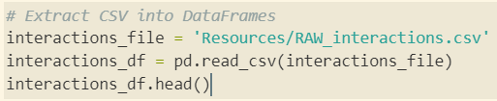
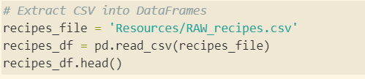
Data source extractions
Kaggle
CSV files used:
RAW_interactions
RAW_recipes

Slide 3
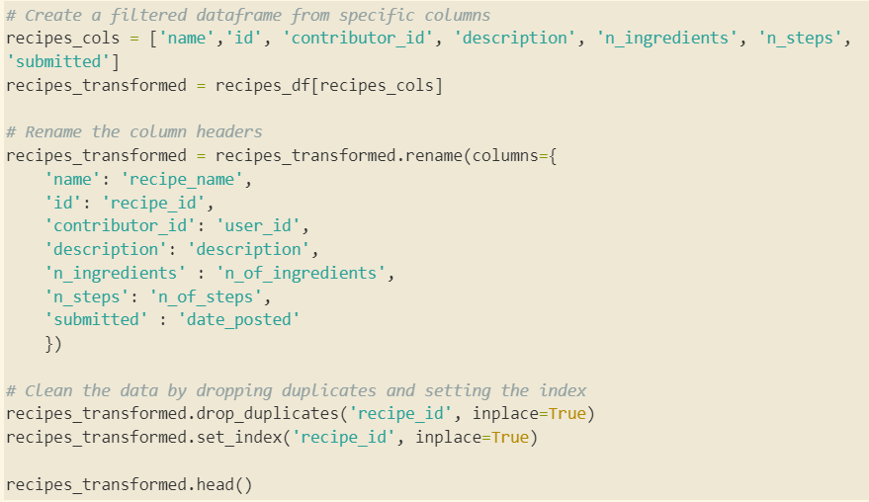
Transformations interactions recipes recipe details
Notes:
Created filtered dataframes and then renames headers. Also, removed duplicates and reset index.

Slide 4
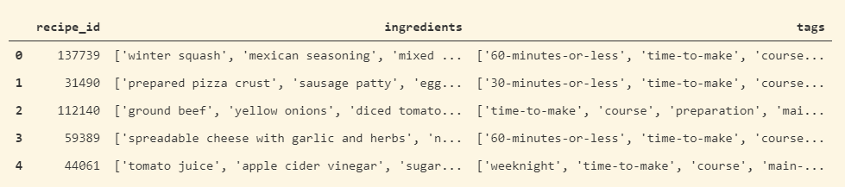
Transformations
Lists of lists…

Slide 5
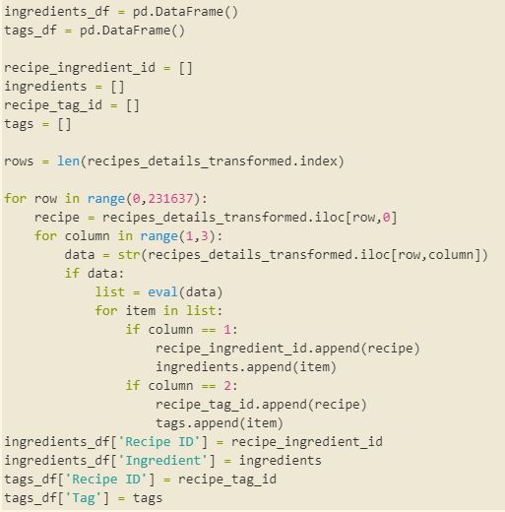
Transformations
Thanks to the help of the great minds in our classroom
Notes:
The eval() method returns the result evaluated from the expression. So in this case, eval is converting the values in the list I am trying to break down into strings as it reads through the list.

Slide 6
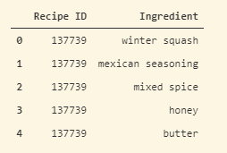
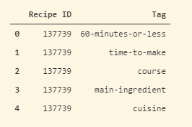
Transformation success!

Slide 7
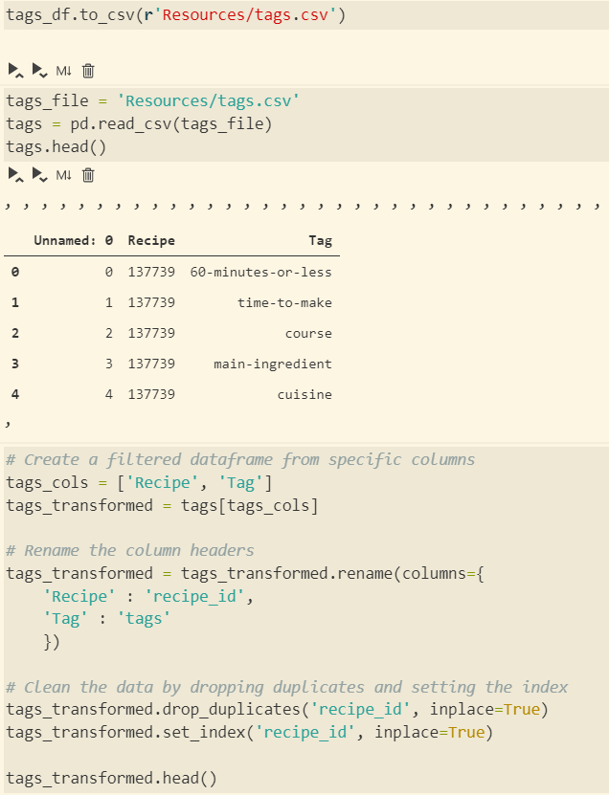
Transformation
Continued…

Slide 8
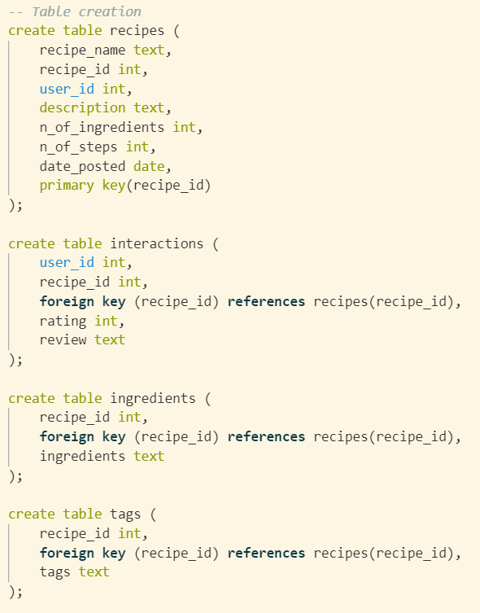
To the database!
Notes:
Used relational database - postgreSQL

Slide 9
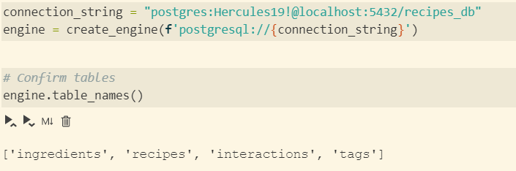
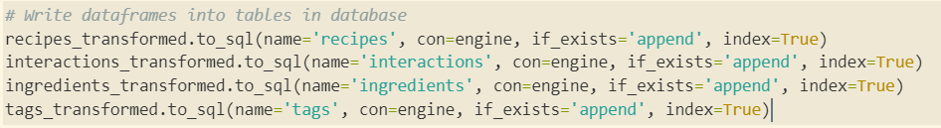
To the database!

Slide 10
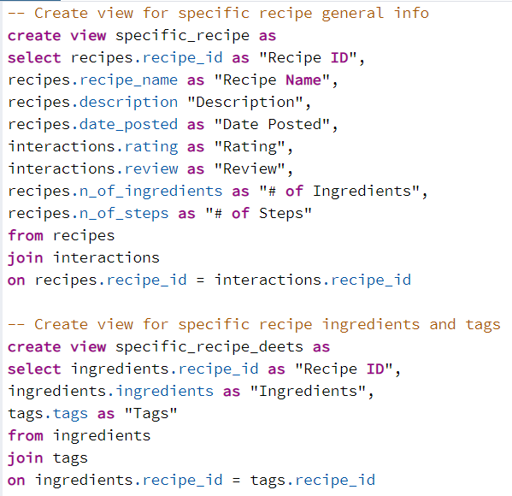
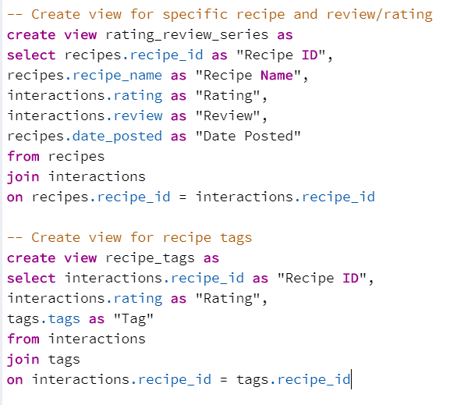
Creating some views

Slide 11
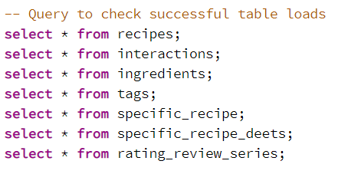
Queries,
Queries,
Queries

Slide 12
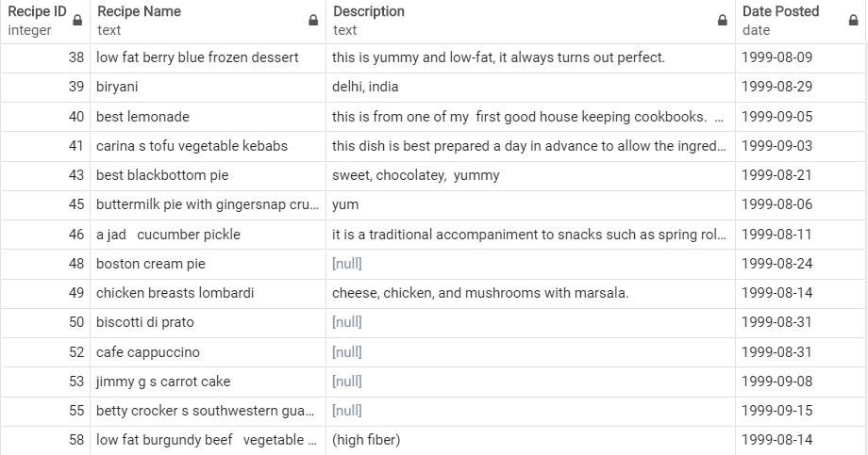
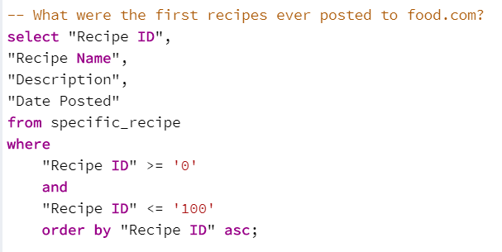
What were the first recipes ever posted to Food.com?

Slide 13
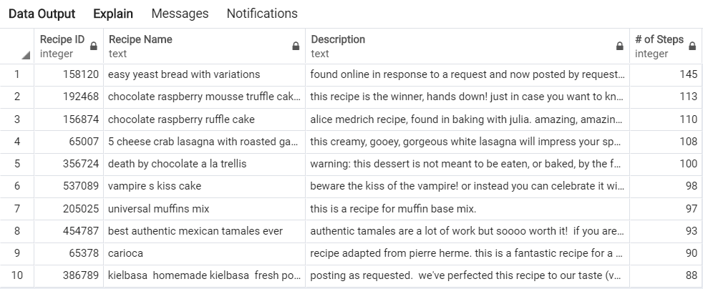
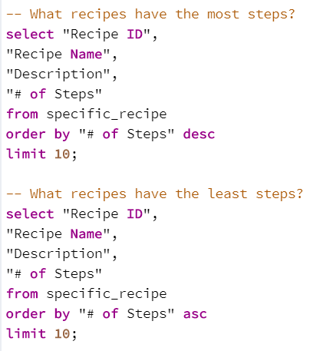
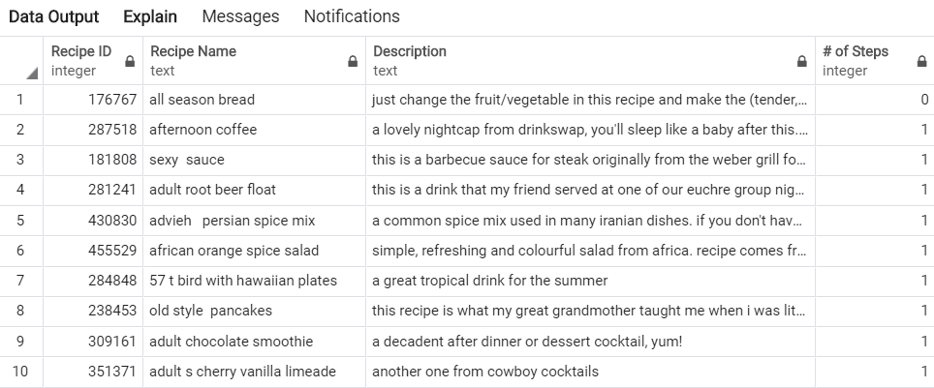
What recipes have the most and least steps?

Slide 14
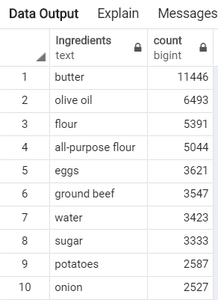
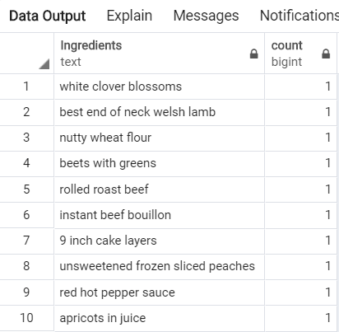
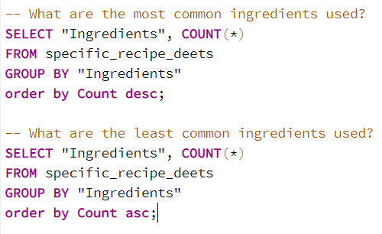
What are the most and least common ingredients used?

Slide 15
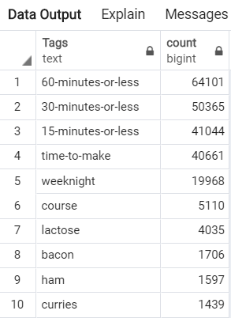
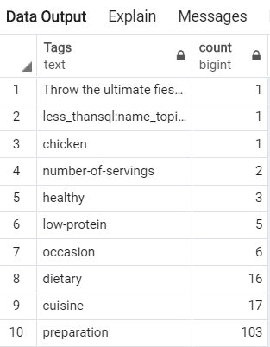
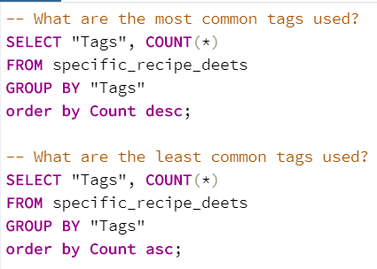
What are the most and least common tags used?

Slide 16
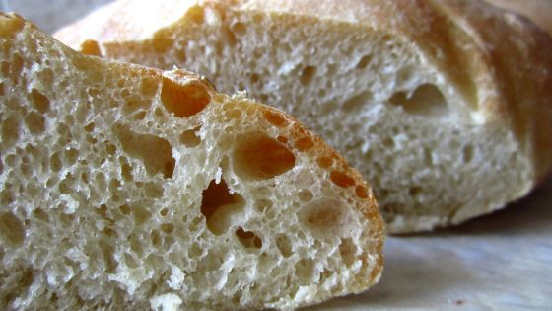
Thanks!

